Slide 1
VEHICLE SERVICE MANAGEMENT SYSTEM
Student name- M.Vidhya
Guide mam- Komala mam

Slide 2
TABLE NAME: BRANCH
FIELD | DATA TYPE | SIZE | CONSTRAINT
Branch id | Int | 10 | Primary key
Branch name | Varchar | 20 | Not null
Land mark | Varchar | 20 | Not null
Pincode | Int | 6 | Not null
Address | Varchar | 30 | Not null

Slide 3
TABLE NAME: CUSTOMER
FIELD | DATA TYPE | SIZE | CONSTRAINT
Customer id | Int | 10 | Primary key
First name | Varchar | 20 | Not null
Last name | Varchar | 20 | Not null
Email | Varchar | 20 | Not null
Age | Int | 10 | Not null
Gender | Varchar | 10 | Not null
Mobile | Int | 10 | Not null
Password | Varchar | 20 | Not null
Address | Varchar | 30 | Not null

Slide 4
TABLE NAME: SERVICE
FIELD | DATA TYPE | SIZE | CONSTRAINT
Service id | Int | 10 | Primary key
Customer id | Int | 10 | Foreign key
Branch id | Int | 10 | Foreign key
Vehicle type | Varchar | 30 | Not null
Vehicle number | Varchar | 20 | Not null
Problem | Varchar | 30 | Not null
Address | Varchar | 30 | Not null
Date | Date | 10 | Not null

Slide 5
TABLE NAME: BILLING
FIELD | DATA TYPE | SIZE | CONSTRAINT
Billing id | Int | 10 | Primary key
Branch id | Int | 10 | Foreign key
Service id | Int | 10 | Foreign key
Amount | Int | 10 | Not null
Return date | Date | 10 | Not null

Slide 6
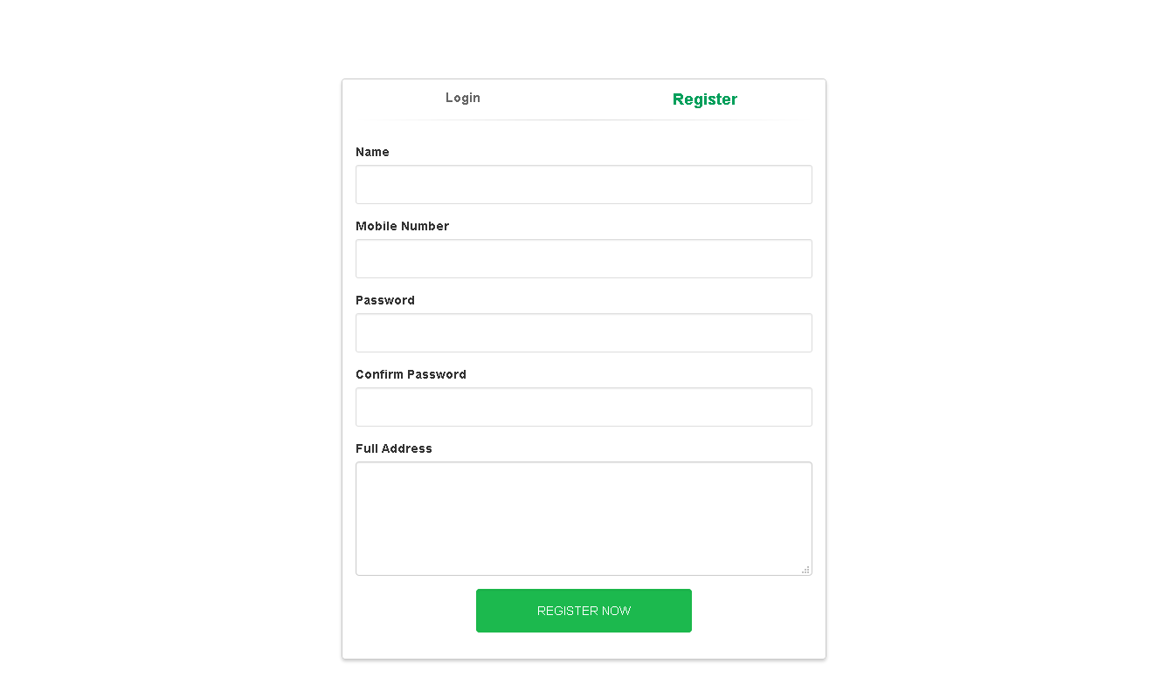

Slide 7
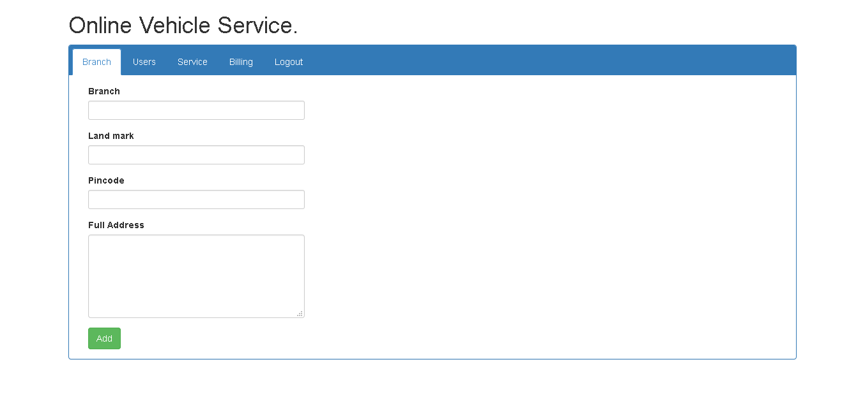

Slide 8
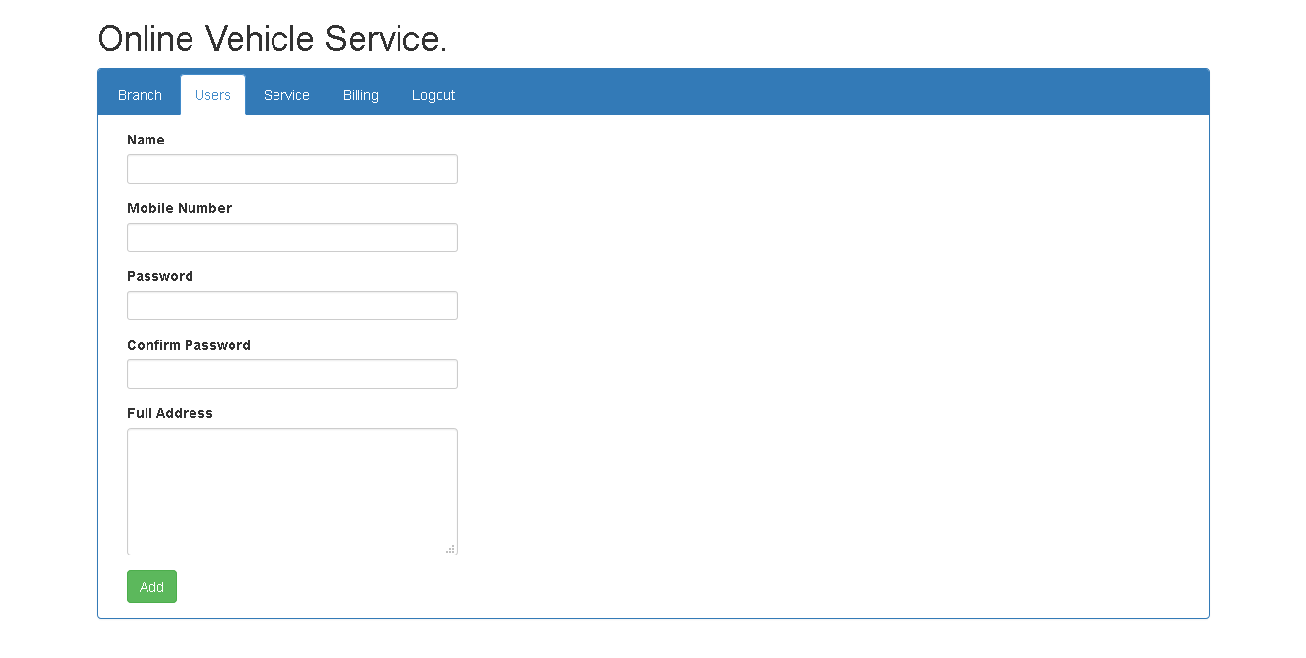

Slide 9
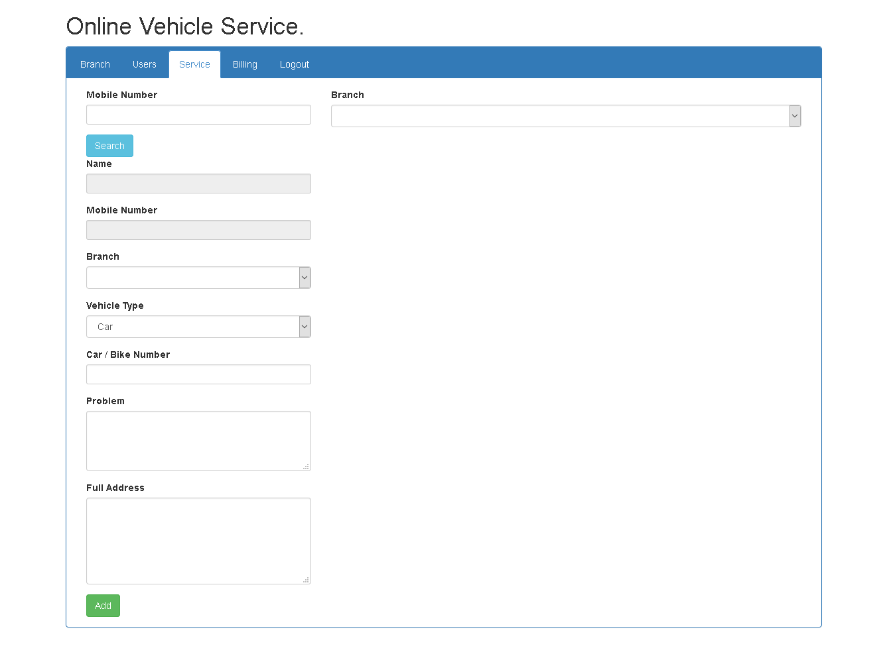

Slide 10
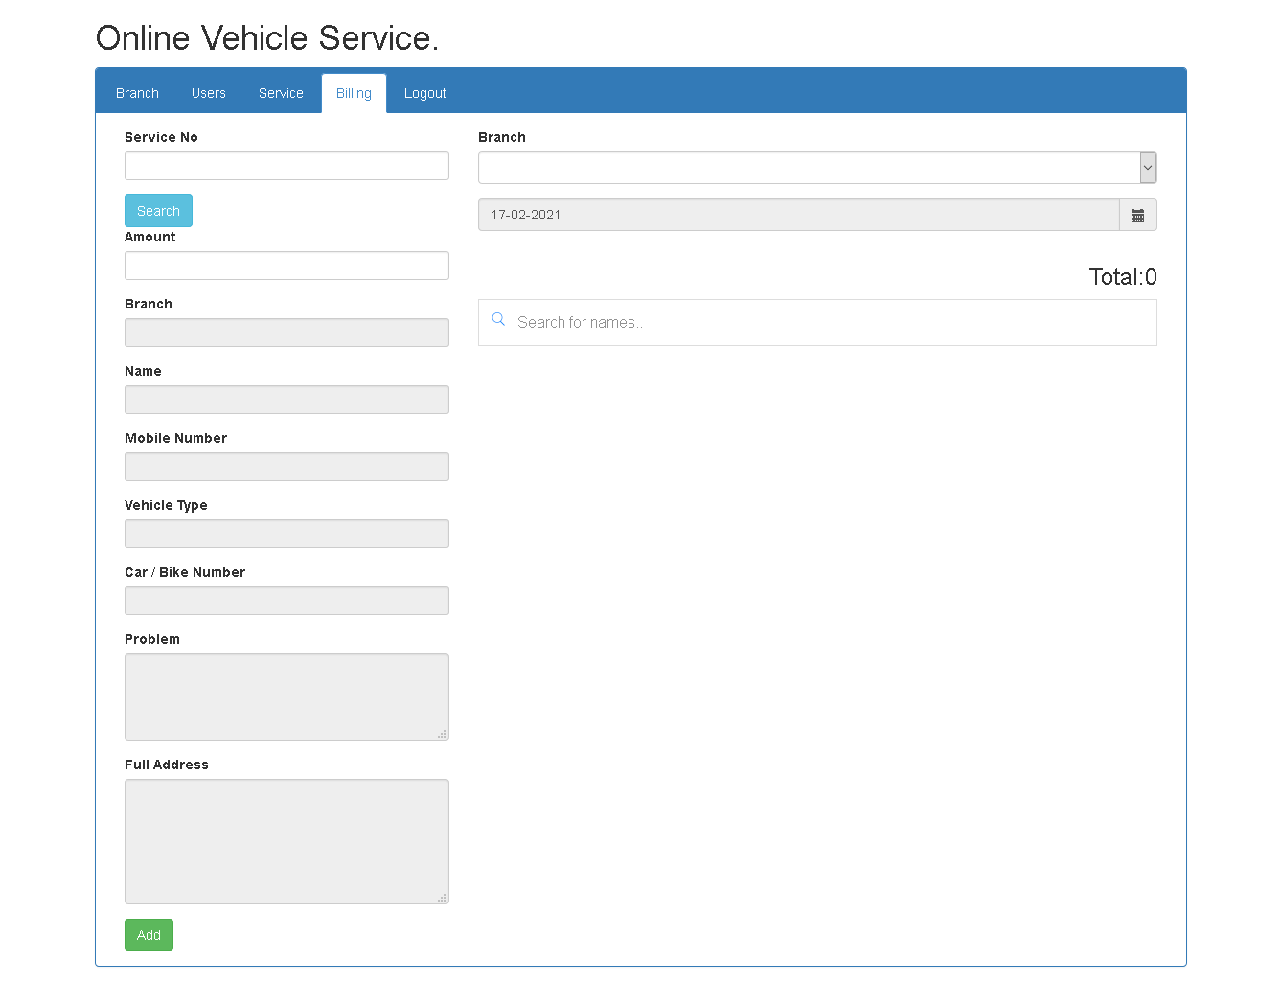

Slide 11
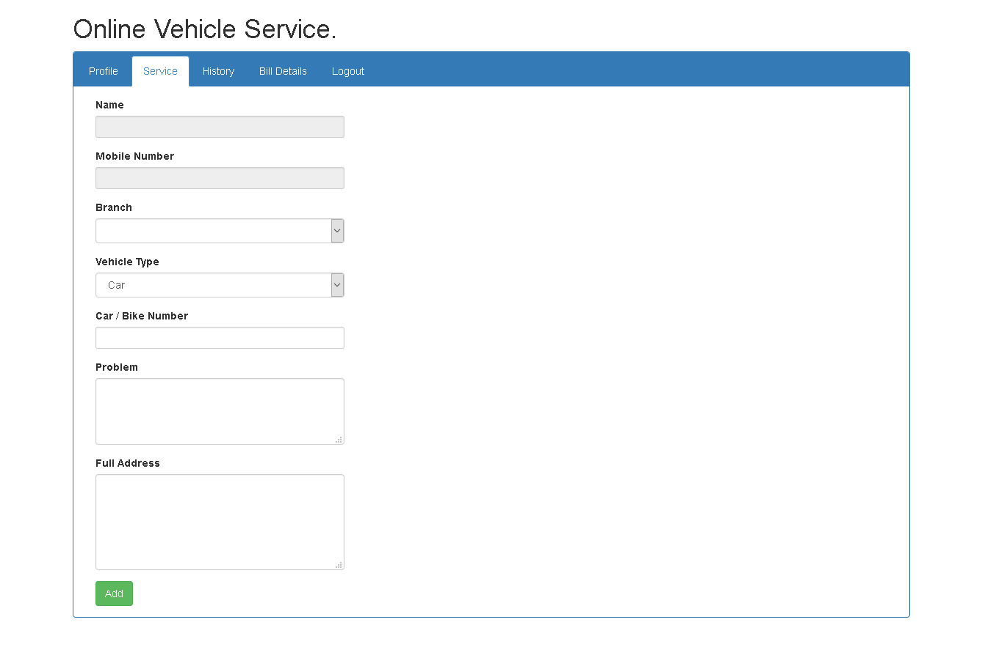

Slide 12
